Slide 1

P peline
The Data
Byte 2
© Jennifer Mankoff
The Data Pipeline; HCII; Spring 2014

Slide 2
Introducing Byte 2
jmankoff-explore.appspot.com
Use data from Google Fusion Tables (& SQL)
Use a key to access an API
Using CSV and JSON
Read and write from files
Conducting exploratory data analysis

Slide 3
Data Set
http://portal.louisvilleky.gov/dataset/animal-services-outcomes-data
Or
https://www.google.com/fusiontables/DataSource?docid=1xXFu8T2xycJprygAzGjhIjhMt9dKY-1Nacq2SjQ#rows:id=1
Lots can be done just with this…

Slide 4
Debugging in Google AppSpot
logger.info()
Understand the flow of information
Working in pure python to test your assumptions

Slide 5
Connecting to Fusion Tables
Manually Register for Key
Need an API Key (instructions on website)
Then use a library to build the URL and post a request
service = build('fusiontables', 'v1', developerKey=API_KEY)
Construct a URL
Post it to the Server
Collect the Response (often XML or JSON)
Parse and Act

Slide 6
Exploring your Table
Manually get Table ID
Also need a TABLE_ID
Then use a library to build requests
request = service.column().list(tableId=TABLE_ID)
gets a list of column names
logging.info(request)

Slide 7
Making a Query
query = # construct query
response = service.query().sql(sql=query).execute()
logging.info(response)

Slide 8
Making a Query
query = "SELECT * FROM " + TABLE_ID + " WHERE AnimalType = 'DOG' LIMIT 2”
INFO 2014-01-07 19:31:41,439 main.py:88] [u'Outcome', u'AnimalID', u'AnimalType', u'IntakeDate', u'IntakeYear', u'IntakeMonth', u'Name', u'Breed', u'Age', u'Sex', u'SpayNeuter', u'Size', u'Color', u'IntakeType', u'OutcomeSubtype', u'ZipFound', u'Latitude', u'Longitude', u'ZipPlaced', u'OutcomeDate', u'OutcomeYear', u'OutcomeMonth', u'icon type', u'IconName']
INFO 2014-01-07 19:31:41,439 main.py:89] [[u'', u'A346562', u'DOG', u'2011-04-16T00:00:00Z', u'2011', u'April', u'DIXIE', u'', u'Older than 1 year', u'MALE', u'true', u'MED', u'BLACK', u'Owner Surrender', u'', u'40218', 38.1938, -85.6573, u'NaN', u'2011-04-16T00:00:00Z', u'2011', u'April', u'NaN', u''], [u'', u'A364651', u'DOG', u'2011-03-11T00:00:00Z', u'2011', u'March', u'KAYLEE', u'YORKSHIRE TERR - POODLE TOY', u'Older than 1 year', u'FEMALE', u'true', u'TOY', u'BLACK', u'Impound', u'', u'40202', 38.2529, -85.7514, u'40218', u'2011-04-01T00:00:00Z', u'2011', u'April', u'NaN', u'']]

Slide 9
Exploratory Analysis
Combination of statistics and graphics
We’ll be talking more about this in lecture

Slide 10
explore.py
Will ‘dump’ all the data into a ‘data.json’ file
Uses try/except to check for the file (only queries when deleted)
Uses nested loops to create a summary of the variety in the data (because so much of it is not numerical)

Slide 11
Summary Structure
{u'Age': {'Older than 7 years': 1250, 'Infant - Younger than 6 months': 1143, 'Older than 1 year': 3794, 'Youth - Younger than 1 year': 915, 'EMPTY': 2533}…}

Slide 12
Summary Structure
{u'Age': {'Older than 7 years': 1250, 'Infant - Younger than 6 months': 1143, 'Older than 1 year': 3794, 'Youth - Younger than 1 year': 915, 'EMPTY': 2533}…}
Column Name

Slide 13
Summary Structure
{u'Age': {'Older than 7 years': 1250, 'Infant - Younger than 6 months': 1143, 'Older than 1 year': 3794, 'Youth - Younger than 1 year': 915, 'EMPTY': 2533}…}
Data Value

Slide 14
Summary Structure
{u'Age': {'Older than 7 years': 1250, 'Infant - Younger than 6 months': 1143, 'Older than 1 year': 3794, 'Youth - Younger than 1 year': 915, 'EMPTY': 2533}…}
Number of times it occurred in the data

Slide 15
Summary Structure
{u'Age': {'Older than 7 years': 1250, 'Infant - Younger than 6 months': 1143, 'Older than 1 year': 3794, 'Youth - Younger than 1 year': 915, 'EMPTY': 2533}…}

Slide 16
Summary Structure
{u'Age': {'Older than 7 years': 1250, 'Infant - Younger than 6 months': 1143, 'Older than 1 year': 3794, 'Youth - Younger than 1 year': 915, 'EMPTY': 2533}…}
Repeats for each column

Slide 17
Pyplot
# make a bar plot of all the latitudes we found
plt.bar(latitude.keys(), latitude.values())
plt.show()
Your code will pause and show a window

Slide 18
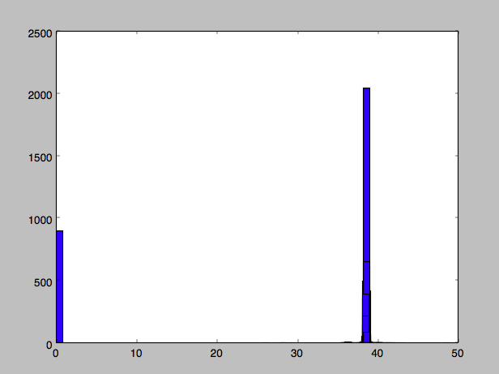
Pyplot
# make a bar plot of all the latitudes we found
plt.bar(latitude.keys(), latitude.values())
plt.show()
Your code will pause and show a window

Slide 19
Pyplot
# make a bar plot of all the latitudes we found
plt.bar(latitude.keys(), latitude.values())
plt.show()
Your code will pause and show a window
When you close it the code continues (i.e. to other plots)

Slide 20
Pyplot
Left side of bar (array)
# make a bar plot of all the latitudes we found
plt.bar(latitude.keys(), latitude.values())
plt.show()
Your code will pause and show a window
When you close it the code continues (i.e. to other plots)

Slide 21
Pyplot
# make a bar plot of all the latitudes we found
plt.bar(latitude.keys(), latitude.values())
plt.show()
Your code will pause and show a window
When you close it the code continues (i.e. to other plots)
Height of bar (array)

Slide 22
Pyplot
# make a bar plot of all the latitudes we found
plt.bar(latitude.keys(), latitude.values())
plt.show()
Your code will pause and show a window

Slide 23
Why so much at 0?
# need to replace the "EMPTY" key with a numeric value for plotting
latitude[0] = latitude['EMPTY']
del latitude['EMPTY']

Slide 24
Why so many EMPTY?
# convert any any empty strings to a string called 'EMPTY' we can use as a value
if value == '': value = 'EMPTY’
if value == 'NaN' : value = 'EMPTY'

Slide 25
Why so many EMPTY?
# convert any any empty strings to a string called 'EMPTY' we can use as a value
if value == '': value = 'EMPTY’
if value == 'NaN' : value = 'EMPTY'
Represents a lack of information about location found

Slide 26
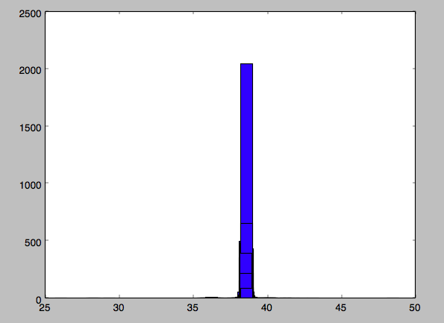
Why so many EMPTY?
# convert any any empty strings to a string called 'EMPTY' we can use as a value
if value == '': value = 'EMPTY’
if value == 'NaN' : value = 'EMPTY'

Slide 27
Why so many EMPTY?
# convert any any empty strings to a string called 'EMPTY' we can use as a value
if value == '': value = 'EMPTY’
if value == 'NaN' : value = 'EMPTY'

Slide 28
Questions you should be able to answer about Byte2
Is the data complete? If not, what is missing and what concerns does it raise?
Is the data coherent?
Does it make sense relative to itself?
Does it match your expectations?
Is the data is distributed across its possible values in a way that makes sense?
Is the data correct?
What aspects of this data can you verify?
What did you find?
Answers could include text, hand drawn images, pyplot images, even interactive graphics

Slide 29
What does the Summary not tell you?
Loses all information about the relationships across columns (i.e. the relationship between age and outcome; zip found and zip lost; and so on)
You may need to change this to explore coherence & correctness

Slide 30
Can you use a different data set?
Absolutely, with instructor approval
Recommend you choose one that is on fusion tables or that you can upload there, if you go somewhere else.

